Slide 1
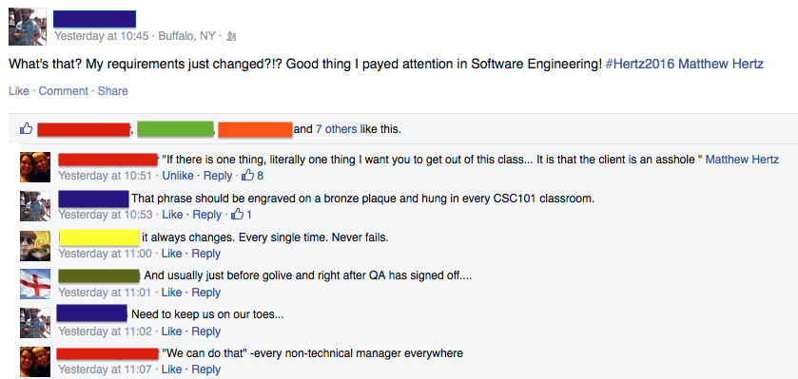
Lecture 5: requirements –or– You Want Me to Do What?
CSE 442 – Software Engineering

Slide 2
Meetings Start Monday
Meet with TA in Baldy 19 at time you selected
Same time, same TA, (same place?) for all but grading
TA's role like that of a manager helping you learn
Help keep members on track & sharing work evenly
Serves as outside helping you improve communication
Focus team on process, rather than just development
Know everyone can hack; meetings not technical
Managers already know skills; rarely review your code
Cannot skip meetings, plus goal is to improve grades

Slide 3
What Is a Requirement?
“[S]pecific thing your system has to do to work correctly”

Slide 4
What’s the Problem? (I)
Viewers need accuracy in forecast to plan for day
In the video, meteorologist prediction correct
Viewers want sunny days & hope forecast says this
When weather does not match hopes, they get upset
No blood sacrifice after poll completed (I hope)
But viewers “requirements” are for sunny weather
But anger greater if forecast wrong; needs beat wants

Slide 5
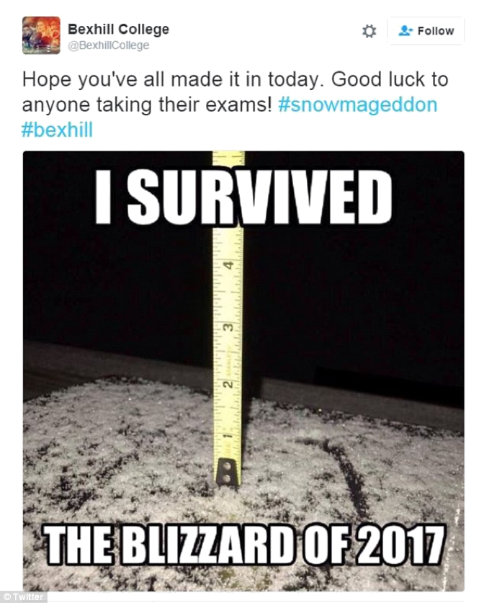
What’s the Problem? (I)
Viewers need accuracy in forecast to plan for day
In the video, meteorologist prediction correct
Viewers want sunny days & hope forecast says this
When weather does not match hopes, they get upset
No blood sacrifice after poll completed (I hope)
But viewers “requirements” are for sunny prediction
But anger greater if forecast wrong; needs beat wants

Slide 6
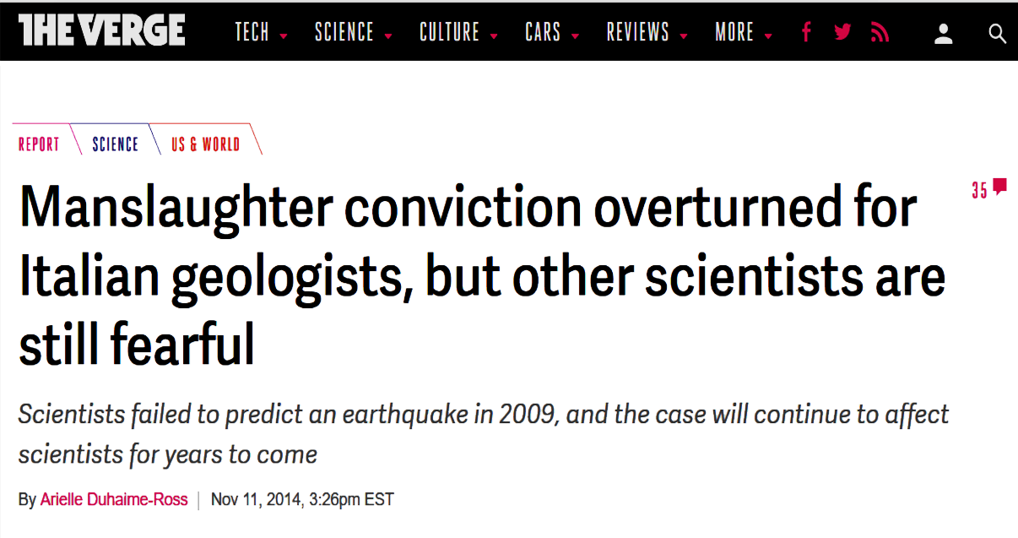
What’s the Problem? (I)
Viewers need accuracy in forecast to plan for day
In the video, meteorologist prediction correct
Viewers want sunny days & hope forecast says this
When weather does not match hopes, they get upset
No blood sacrifice after poll completed (I hope)
But viewers “requirements” are for sunny prediction
But anger greater if forecast wrong; needs beat wants

Slide 7
Requirements Key #1
Capture features needed to solve problem NOT features wanted by users

Slide 8
What’s the Problem? (II)
Finding needs within wants hard, but critical to do
But both depend on user’s defining what will be success
Moving target problem created by users views
Once they see example, explain how does not match
Changes continue as you get closer to mental image
After delivery, find more changes to meet their needs

Slide 9
What’s the Problem? (II)
Finding needs within wants hard, but critical to do
But both depend on user’s defining what will be success
Moving target problem created by users views
Once they see example, explain how does not match
Changes continue as you get closer to mental image
After delivery, find more changes to meet their needs
Exactly 1 thing will not change in project
You will always be fighting people's desire for change

Slide 10

Moving Target Problem
Difficult
Notes:
Think of every programming assignment you have ever been asked to do

Slide 11
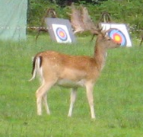
Moving Target Problem
Difficult
EXTREMELY Difficult
Notes:
Now imagine the Prof. changes his mind every few days (x 100)

Slide 12
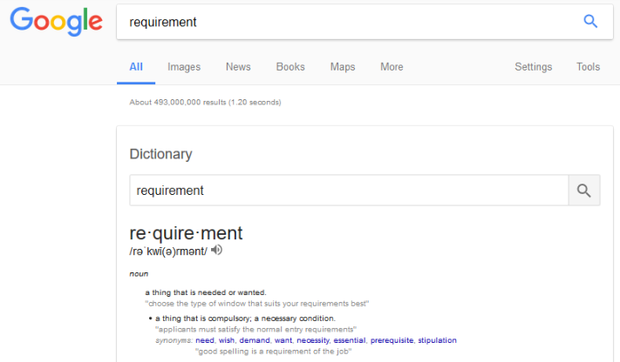
Why Do They Change?
Included contradictory or ambiguous requirements
Did not identify clients’ needs within list of wants

Slide 13
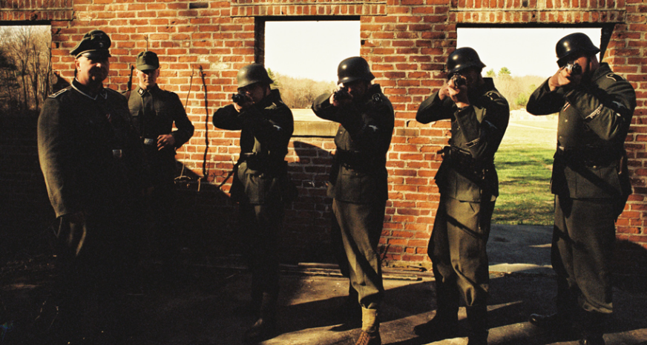
Why Do They Change?
Included contradictory or ambiguous requirements
Did not identify clients’ needs within list of wants
Requirements not understood by designers & coders
Client changes their mind later on in the process

Slide 14
Answer is Key to Course
Communication

Slide 15
Requirement Keys
Document what is required: Be specific on needs
Omit unnecessary details: Focus on substance not style
State what “success” is like: Write acceptance tests now
Notes:
Need to keep customer from changing mind
- Be certain you know what they are saying
- Be certain they know what they are saying
- Defer decisions as long as there is other work to do

Slide 16
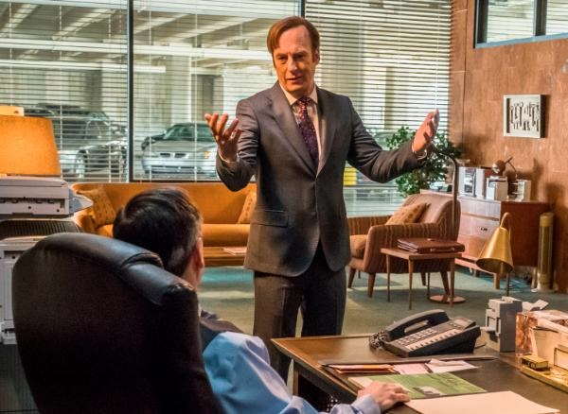
Why Requirements are Hard
All of your requirements must be meaningful to
Client
Designers
Developers
Users
Legal

Slide 17
How To Do This?
People ♥ stories Use stories to document
Understood by everyone; detailed, but not technical
Describes system details from user’s perspective
Cause-and-effect documented with needed details
Can provide insight into requirement’s importance
Automatically testable; story states effects of actions

Slide 18
Too Much vs. Too Little
Limit stories to highlight only required details
What occurs & why it happens are important to know
Clients, developers, & legal must agree on these details
How it happens unimportant: nobody cares (& will change)
Cannot just settle; must keep asking questions
“But what if ____” finds errors system must handle
Assume worst & ask “What problems could occur?”
“Is this really needed?” avoids documenting wants

Slide 19
User Stories to the Rescue
Lightweight approach for capturing requirements
Story documents single system interaction by user
Details will change so does not waste time on them
Needs fluctuate, so requirements readable by client
Explains why requirement needed to allow prioritization

Slide 20
User Stories to the Rescue
Lightweight approach for capturing requirements
Story documents single system interaction by user
Details will change so does not waste time on them
Needs fluctuate, so requirements readable by client
Explains why requirement needed to allow prioritization
When change expected, can better use resources
Cheap to create since user story often single sentence
May never be implemented, so eschews most details
Keeps focus on conversation rather than processes
Waterfalls need not apply, common in iterative models

Slide 21
User Story Basics
Short statement of customer values and wants
User’s view of feature described often in first person
For each feature, explains how & why user acts
Story should be testable: successful results shown
Provides enough detail to create further client dialog
Each story often a sentence, rarely more than two

Slide 22
User Story Basics
Short statement of customer values and wants
User’s view of feature described often in first person
For each feature, explains how & why user acts
Story should be testable: successful results shown
Provides enough detail to create further client dialog
Each story often a sentence, rarely more than two
“The gambler comes up and places his bet.”

Slide 23
User Story Basics
Short statement of customer values and wants
User’s view of feature described often in first person
For each feature, explains how & why user acts
Story should be testable: successful results shown
Provides enough detail to create further client dialog
Each story often a sentence, rarely more than two
“The gambler comes up and places his bet.”

Slide 24
User Story Basics
Short statement of customer values and wants
User’s view of feature described often in first person
For each feature, explains how & why user acts
Story should be testable: successful results shown
Provides enough detail to create further client dialog
Each story often a sentence, rarely more than two
“As a gambler, I place my bet.”

Slide 25
User Story Role
Written from user’s perspective: Document user's view;

Slide 26
User Story Role
Written from user’s perspective: Document user's view; including who they are (which is never user)*
Notes:
* Unless you are writing program for people actively engaging in illicit substance abuse

Slide 27
User Story Basics
Short statement of customer values and wants
User’s view of feature described often in first person
For each feature, explains how & why user acts
Story should be testable: successful results shown
Provides enough detail to create further client dialog
Each story often a sentence, rarely more than two
“As a gambler, I place my bet.”

Slide 28
User Story Basics
Short statement of customer values and wants
User’s view of feature described often in first person
For each feature, explains how & why user acts
Story should be testable: successful results shown
Provides enough detail to create further client dialog
Each story often a sentence, rarely more than two
“As a gambler, I want to place my bet so I can play blackjack.”

Slide 29
User Story Action
Actions story’s user will do to achieve their goal

Slide 30
User Story Basics
Short statement of customer values and wants
User’s view of feature described often in first person
For each feature, explains how & why user acts
Story should be testable: how do we know it works?
Provides enough detail to create further client dialog
Each story often a sentence, rarely more than two
“As a gambler, I want to place my bet so I get dealt a hand.”

Slide 31
User Story Basics
Short statement of customer values and wants
User’s view of feature described often in first person
For each feature, explains how & why user acts
Story should be testable: successful results shown
Provides enough detail to create further client dialog
Each story often a sentence, rarely more than two
“As a gambler, I want to place my bet so I get dealt a hand.”

Slide 32
User Story Reward
Why is system used to accomplish goal & how will user know it worked?

Slide 33
Be Wary of Details
“As a gambler, I want to place my bet so I get dealt a hand.”
How is a bet is placed?
Possibilities include credit cards, chips, implantable IDs
This could change, but does not change user's story
Each story is part of a dialog may not be fully formed
Negotiations on details occur when stories developed
Many ideas never get coded, this avoids losing time

Slide 34
Story Documents 1 Feature
Story written for each feature program could include
Story centers on a story; implementation not discussed
Write what the role experiences; omit all other details
“As a player happy with my cards, I want to stand with hand so I can see if I won.”
"As a casino owner I want to increase my profits so betting is not in cash."

Slide 35
Useful User Stories
Must deliver what client expects;

Slide 36
Useful User Stories
Must deliver what client expects;
Stories written for clients to understand

Slide 37
User Story Gotchas #2
Some features fixed; many details change
Only include needed features in story

Slide 38
User Story Gotchas #2
Some features fixed; many details change
Only include needed features in story

Slide 39
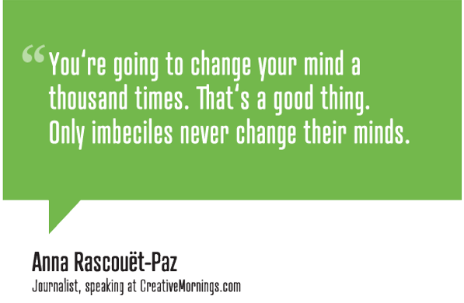
Why User Stories?

Slide 40
User Story Outline
“As a <role>, I want <action> so I <testable reward>.”
Most common template used for user stories
But these are stories, so templates not required/used
Lots of roles exist among the users of a system
Customer representative (or clients) present most ideas
Others may exist: big betters expect special treatment
Team brainstorm roles and see if stories might change
Bring ideas back to conversation: client has final say

Slide 41
User Story Outline
As a <role>, I want <action> so I <testable reward>.

Slide 42
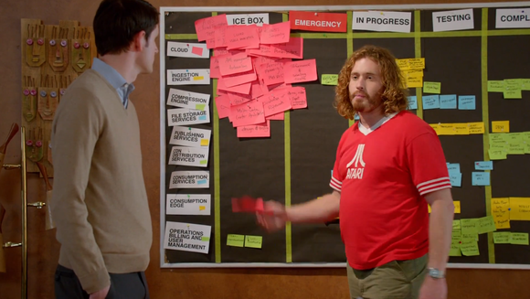
How Many Stories Needed?
User stories intended to be very, very cheap & easy
All potential ideas written up; many never implemented
Sprints begin when pick important stories from backlog
Stories will get “stale”; discard if too old (or not needed)
May end up circling around; no shame in recreating story

Slide 43

Knowing When Story “Done”
When story included in sprint, need acceptance tests
Used to check that story done & implemented correctly
Often step-by-step script of actions & correct outcomes
Uses non-technical language, since run by clients
At least 1 test, but okay to have multiple tests for 1 story

Slide 44
Making It Work
Once acceptance test(s) written, make tasks for story
Tasks are concrete steps needed to implement story
By creating tasks, team organizes work to be done
Each task stands alone, but some may “block” others
Created & used by developers; technical words fine here
Tasks added to scrum board showing work for sprint
Easy to avoid conflicts by marking task while completing
Update status as you go; scrum board shows what to do
Can also place commits in context – message links to task

Slide 45
Story Telling A Skill
Storytelling & writing are skills like any other
Kids’ stories hard to follow and often have no point
With experience & lots of practice storytelling improves
Notes:
Picture of The Storyteller by Jacques Clement Wagrez was taken and entered into public domain by Irina. The original image is available at: https://www.flickr.com/photos/repolco/23308008285

Slide 46
Tools To Use
Project must be shared in group using a GitHub/BitBucket repo
Combines free space & excellent reliability
Scrum board support via ZenHub/etc
Direct connections supported, connects to GitHub repo
Does use full project budget ($0 -- accounts are free)
Many teams using Trello
It is up to your team to link your scrum board with your repo
Should be simple to go from task on scrum board to branch/commits/pull requests/code associated with that task
Should be simple to find acceptance tests for each story

Slide 47
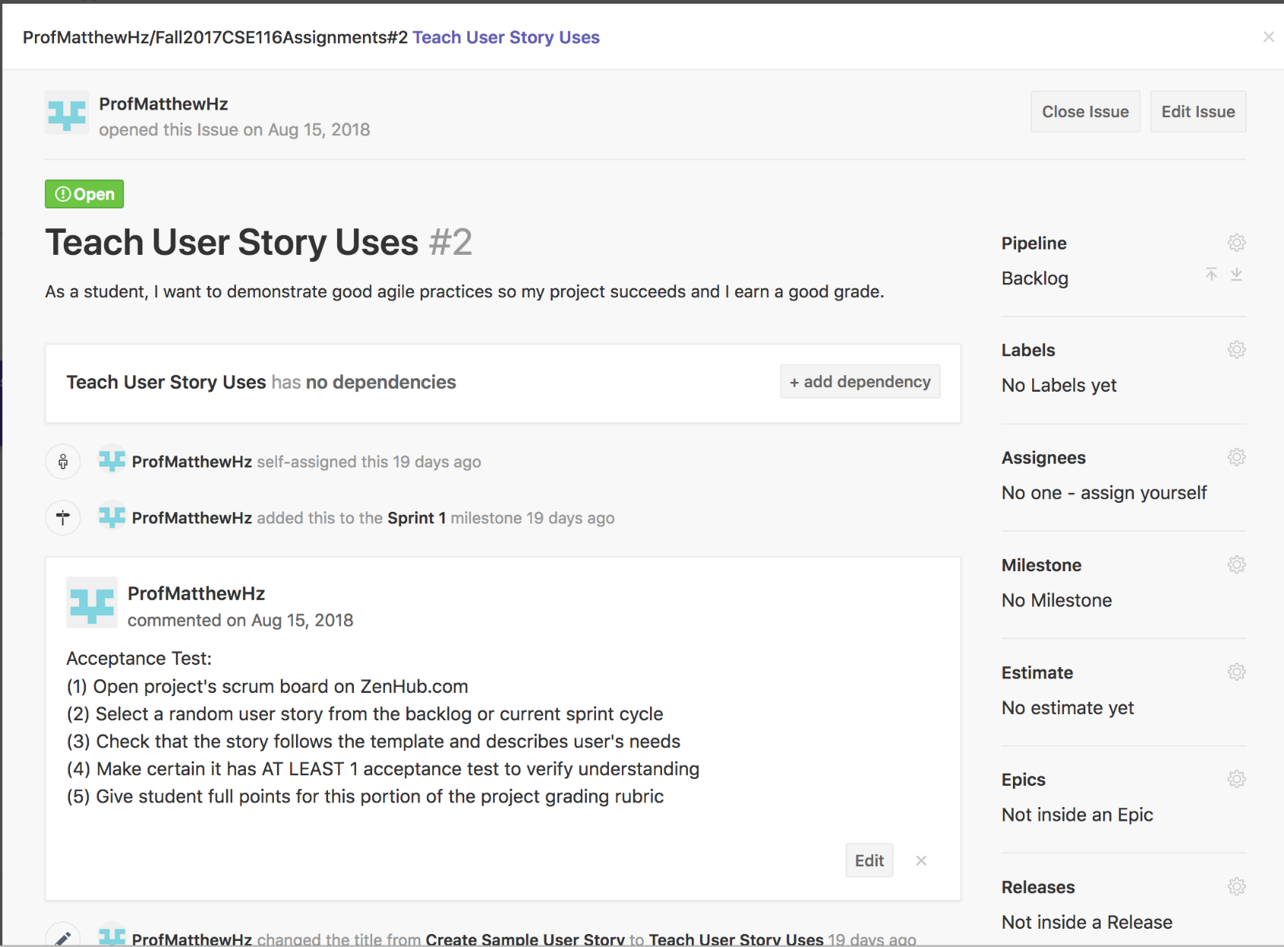
Example Story in ZenHub

Slide 48
Lecture 7: Stories, Tasks & Boards, oh My!
CSE 442 – Software Engineering

Slide 49
Project Requirements
User stories log requirements for our project
Each story details feature for program to meet needs
To understand details, must use common language
Share stories to avoid technical jargon (on both sides)
Keep asking questions to learn what happens & why
Client’s world complex & we are newbies in it
Expressing desires hard; clients novices in our world
Trust, but verify; change inevitable & mistakes constant
Must bridge this gap: user-focused stories do great job

Slide 50
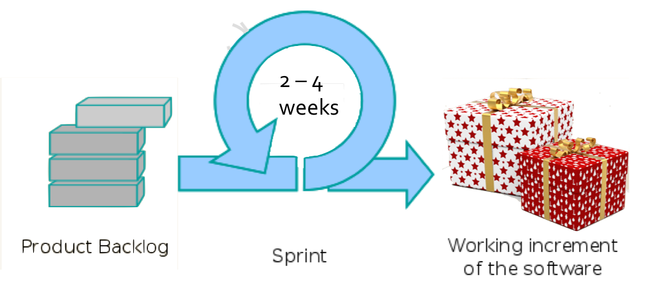
Scrum Development Overview
"User Stories"
Notes:
Picture of "Bow-boxes-celebration" was added to public domain by Pixabay.com. Original image is available at: https://www.pexels.com/photo/bow-boxes-celebration-gifts-260188/
Picture of "Scrum Process" by Lakeworks and used under a CC BY-SA 3.0 license. The original image is available at: https://commons.wikimedia.org/wiki/File:Scrum_process.svg

Slide 51
User Story Gotchas
Writing takes practice & some stories easier to make
All requirements matter; simple stories help fill in cycles
Some requirements complex, but will fit in template
If user is not part of story, consider if feature needed
Technical details rarely important to include in story
Focus on providing client value by meeting their needs
YAGNI always applies; (politely) use it to keep focus
Customers want stuff to work; pay you to make it work
No change in story from optimizations (invisible to user)

Slide 52
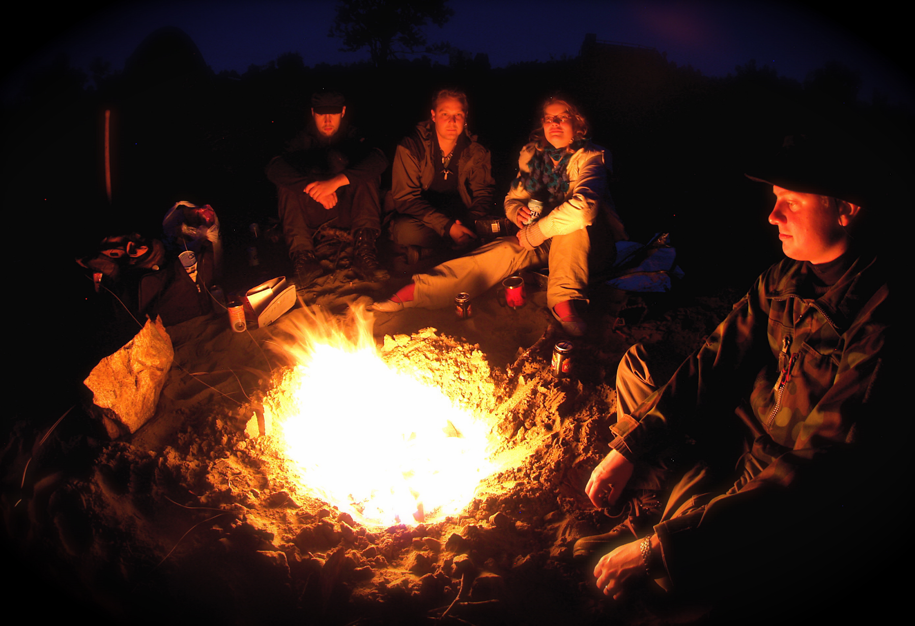
Gathering Needs Key Concept
Notes:
Image of "Campfire on Kaamanen road" by Ville Miettinen and used under CC-BY-NC 2.0 license. Original image is available at: https://www.flickr.com/photos/wili/233621595

Slide 53
Language Still Imprecise
Problems still possible, even if all agree on story
Simple template leaves space for differences in meaning
Confirm understanding now to avoid issues later
Easiest approach is putting requirements through test(s)

Slide 54
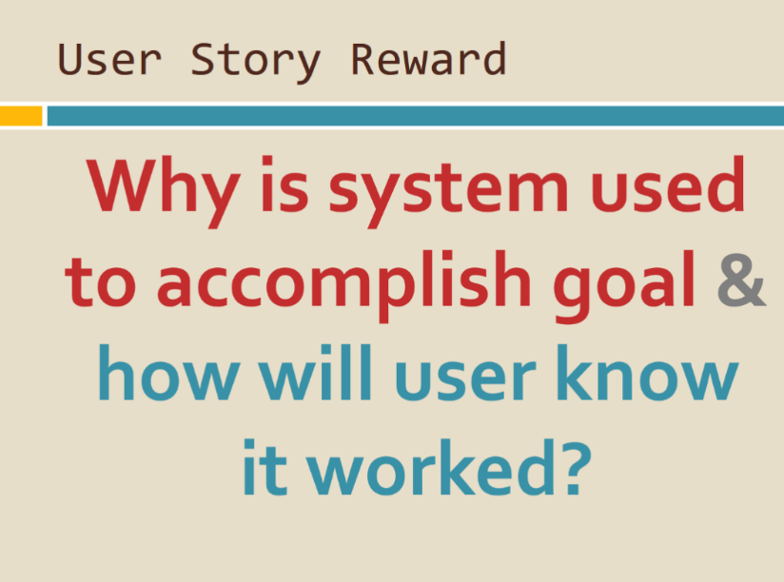
Language Still Imprecise
Problems still possible, even if all agree on story
Simple template leaves space for differences in meaning
Confirm understanding now to avoid issues later
Easiest approach is putting requirements through test(s)

Slide 55
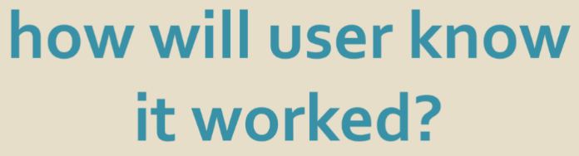
Language Still Imprecise
Problems still possible, even if all agree on story
Simple template leaves space for differences in meaning
Confirm understanding now to avoid issues later
Easiest approach is putting requirements through test(s)

Slide 56
Language Still Imprecise
Problems still possible, even if all agree on story
Simple template leaves space for differences in meaning
Confirm understanding now to avoid issues later
Easiest approach is putting requirements through test(s)
Acceptance test(s) confirm story's meaning & needs
Tests document how user knows story complete
Provides confirmation as to what story is specifying
Confidence increases by describing correct outcome(s)

Slide 57
Tests Integral To Stories
Initially, tests list expectations of what will happen
Test may not be complete: often missing steps or results
Evidence story not ready, but just needs more discussion
Add, modify & remove tests as discussions happen
Spark more talks from ideas captured in lousy tests
Will converge over time as understanding reached
Eventually test(s) stabilize & written for user to run
Only then story ready for scheduling in sprint & coding

Slide 58

What Goes Into a User Story
User stories have three critical aspects. We can call these Card, Conversation, and Confirmation.
Ron Jeffries
Notes:
Picture used under the "Fair Use" exception to copyright law. The original image is from Ron Jeffries twitter feed: https://twitter.com/RonJeffries

Slide 59
What Goes Into a User Story
User stories have three critical aspects. We can call these Card, Conversation, and Confirmation.
User stories simple; Text should fit on index card
Ron Jeffries
Notes:
Picture used under the "Fair Use" exception to copyright law. The original image is from Ron Jeffries twitter feed: https://twitter.com/RonJeffries

Slide 60
What Goes Into a User Story
User stories have three critical aspects. We can call these Card, Conversation, and Confirmation.
Conversations key;
user stories just to record result
Ron Jeffries
Notes:
Picture used under the "Fair Use" exception to copyright law. The original image is from Ron Jeffries twitter feed: https://twitter.com/RonJeffries

Slide 61
What Goes Into a User Story
User stories have three critical aspects. We can call these Card, Conversation, and Confirmation.
Meaning matters
Acceptance tests required
to confirm understanding
Ron Jeffries
Notes:
Picture used under the "Fair Use" exception to copyright law. The original image is from Ron Jeffries twitter feed: https://twitter.com/RonJeffries

Slide 62
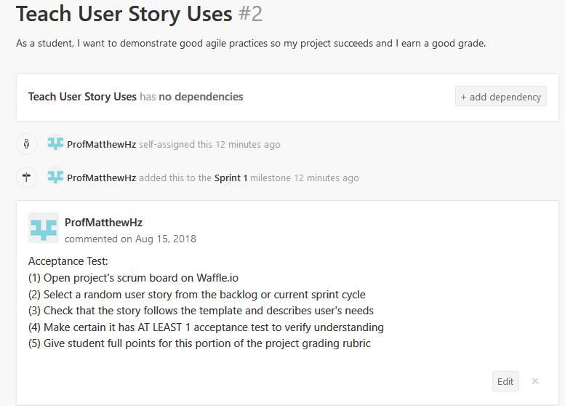
User Story in ZenHub

Slide 63
User Story in ZenHub
Card

Slide 64
User Story in ZenHub (not)
Conversation
Notes:
Image of "Campfire on Kaamanen road" by Ville Miettinen and used under CC-BY-NC 2.0 license. Original image is available at: https://www.flickr.com/photos/wili/233621595

Slide 65
User Story in ZenHub
Confirmation

Slide 66
"Product Backlog"
User stories that not developed, rejected, nor active
Anyone at any time can add a new story to backlog
Emphasis is capturing ideas – many not developed
Product Owner set priorities of each story in backlog
Usually write many stories, so expect many to be tossed
Rejection not forever, some tossed stories will reappear
Goal is to handle change, allows for reprioritization

Slide 67
Sprint Planning
Every sprint begins with meeting planning sprint
Predictions "impossible”; only consider current sprint
Team starts by reviewing & revising backlog stories
Clarify meaning & write better tests with current info
Using team's input, product owner reprioritizes stories
Stories for current sprint chosen by entire team
Look for features that both easy & provide real value
Skip unclear or low priority stories, since deadlines tight

Slide 68
Selecting Sprint’s Stories
Most valuable stories chosen for current sprint
Client needs to be impressed; selecting too little bad
Cannot overcommit & promise more than can be done
Need estimates so best possible decisions made
Requirements documented, but few technical details
But details needed for estimates (& completing work)
Notes:
Picture of "Packing List" by Steve Hodgson used under a CC BY-SA 2.0 license. The original image available at: https://www.flickr.com/photos/craiglea/3677902616

Slide 69
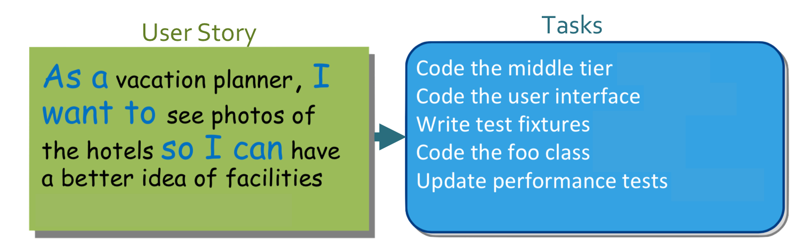
Stories Become Tasks
Team divides selected user stories into 1+ tasks
Each task is work item completed by one person(ish)
Tasks for development team: technical details important
High-level details only; implementation issues avoided

Slide 70
Task Time Estimation
In planning meeting, estimate each task's time
Have limited details; not enough for precise metrics
Instead, rely upon intuition & "wisdom of the crowds"
"Planning poker" process converges on task ideal times

Slide 71
Planning Poker Hand
Notes:
Picture of “Planning poker! I've a straight flush!” by Joel Bez used under a CC-BY 2.0 license. The original image is available at: https://www.flickr.com/photos/lejoe/4553607341/in/photostream/

Slide 72
Sprint Backlog
Name for list of tasks created for current sprint
Add to "In Progress" pipeline at the start of the sprint
During sprint, provides easy communication of state
Members select task to complete; work not assigned
Any unclaimed, unblocked "In Progress" tasks selected
Can update work estimate if unexpected issues arise,
If even greater effort needed, can divide into more tasks
Low overhead & no duplication of effort with system

Slide 73
Once a Task is Yours
After assigning task to self, time to get to work
If it did not exist, create branch for user story
Can create branch for task within user story branch
Start doing work needed to complete task in branch
Tag task in commit message for easy documentation
No effort way which allows others to follow progress
Much of "why" automatic, so reduces detail needed
When others try understanding changes, no need to ask

Slide 74
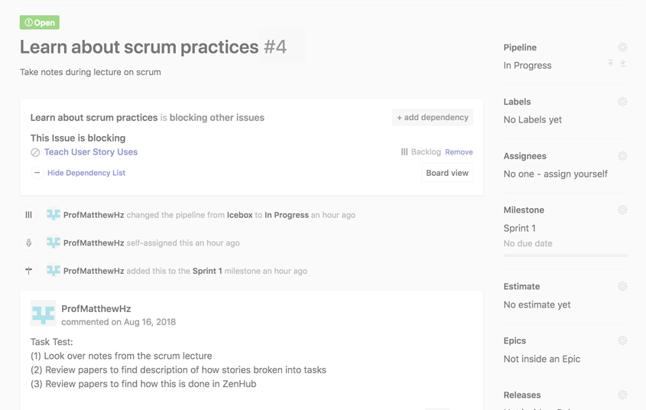
Assigning Task To Self
ZenHub automatically connects when tag included in commit message

Slide 75
Responsibility Sucks
Bugs will occur later & but whose task responsible?
Sometimes turns into argument between developers
Nobody wants blame so it clearly must be other person
No time to review all code; manager just wants fixed
How to make this decision?

Slide 76

Responsibility Sucks
Bugs will occur later & but whose task responsible?
Sometimes turns into argument between developers
Nobody wants blame so it clearly must be other person
No time to review all code; manager just wants fixed
How to make this decision?

Slide 77
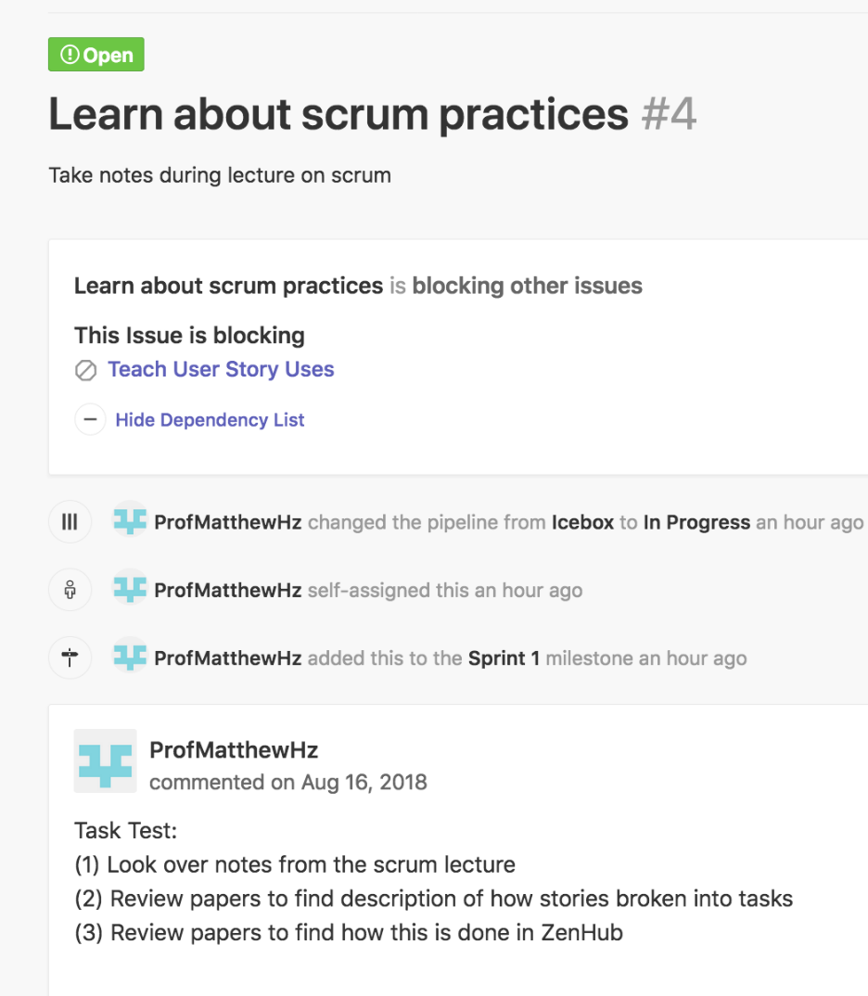
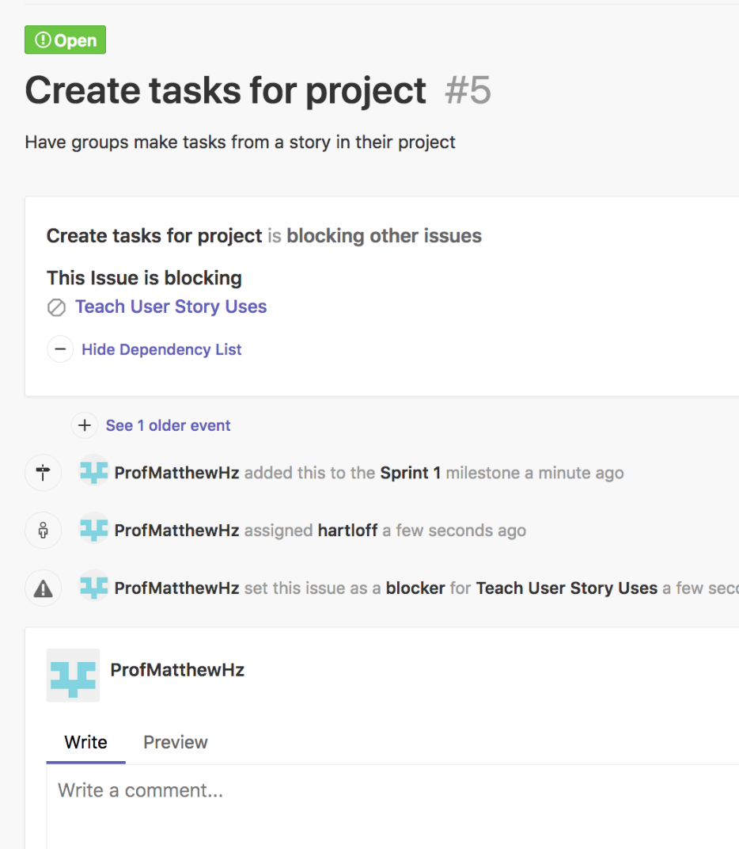
Whom Would You Trust?
"I am certain my task works"
"I know my task works"

Slide 78
Task Tests
Tasks also need tests to know when work complete
You know work correct, but increases others confidence
Proves bug not your fault when mistakes arise later on
Since using good practice, improves teams trust later
More options for task test(s) since tasks technical
For tasks about code, list unit tests created for task
Scripts showing how to see success can also be provided
Cannot prove success, but building confidence in result

Slide 79
Testing Key Concept
Write tests to guide development, simplify debugging & build confidence
Notes:
Cannot prove success using tests. So purpose cannot be correctness. Instead…

Slide 80
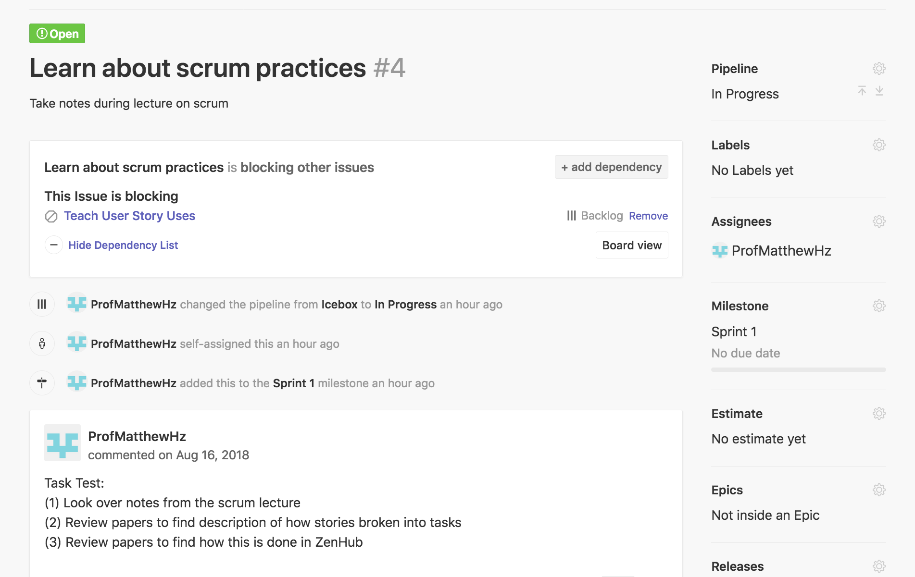
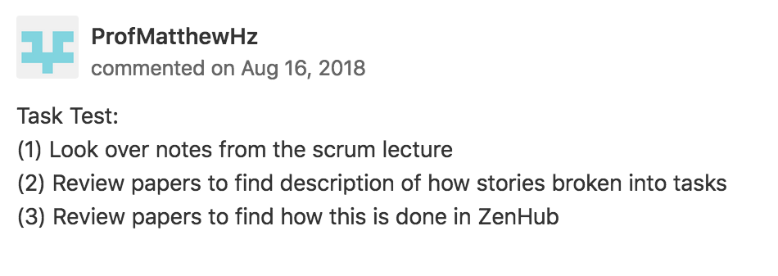
Task Tests

Slide 81
Mischief Managed
Should let others know once task completed
Other tasks may be blocked until know your task works
Stories near completion clarified & should be finished
Document your value so boss can see you being busy
Mark tasks "Closed" when finished & tested
Will also merge task branch back into story's branch
Can merge story branch to dev, if story now complete
Always more to do! Assign self to another task

Slide 82
Key Sprint Challenges
Need for management remains even with Scrum
Important to hold team accountable for sprint demands
Individuals accountable to team for doing their share
Keep focus on goals to allow selecting best tasks to do
Track work completion to allow sprint plan changes
Add more stories to sprint if more work needed
If too much remains, triage stories for postponement
Agility is the key; important to have quick reactions

Slide 83
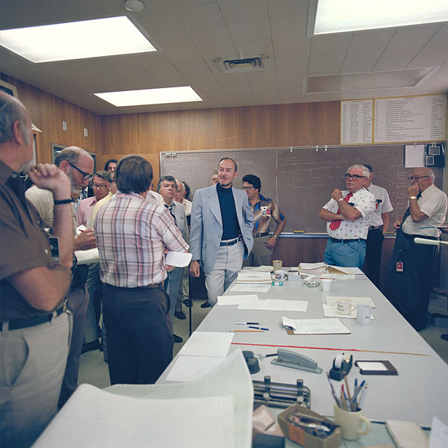
Daily Scrum/Standup Meeting
Workdays start with 15-minute meeting – always
Time limit very strictly enforced; keeps things quick
Once ended, smaller conversations follow-up issues
No chairs allowed; required standing keeps it brief
Notes:
Picture is a daily stand-up from NASA's Saturn Project in 1979. This is not a new idea.
Original image of "Pioneer Saturn- project manager daily stand up meeting" by NASA and, as government property, is in the public domain. Download available at: https://www.flickr.com/photos/nasacommons/4994063804/

Slide 84
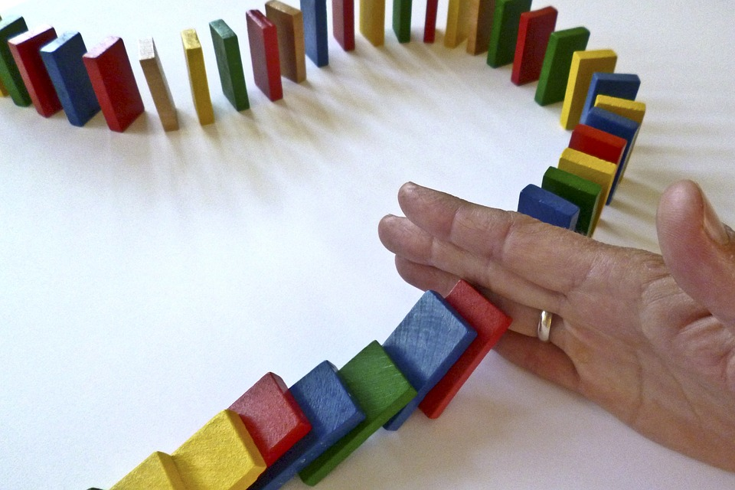
Daily Scrum
Point is accountability & not solving problems
Goal is avoiding meeting; defeats purpose if too long
All team members share status (except ScrumMaster)
Only sharing updates, wait for meeting end to comment
Notes:
"Dominoes stopped by hand" originally by CSchmidt-EC and donated to public domain. Original image is available at: https://pixabay.com/en/dominoes-domino-barricade-hand-1902622/

Slide 85
Standup Status Update
What you did yesterday
What you will do today
What, if anything, prevents progress

Slide 86
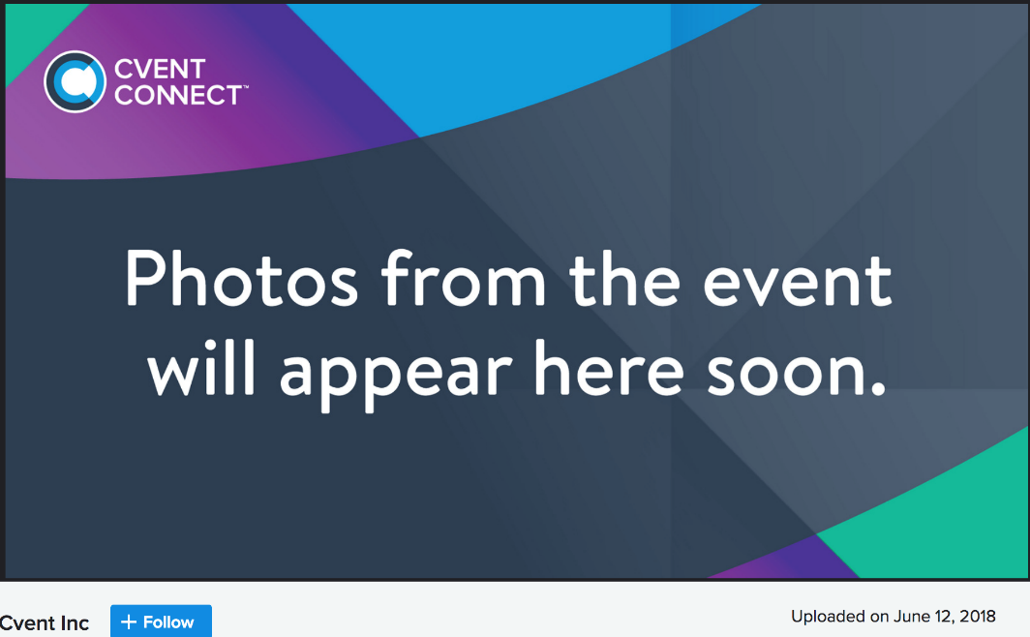
Daily Scrum Mistakes
Biggest mistake: tardy/skipping daily standup
Unfair to teammates – must guess at your progress
Teammates should assume slacking – accountability lost
Disrespectful to others – later time needed for questions
Rituals need repetition – longer meetings could occur

Slide 87
Daily Scrum Mistakes
Annoying mistake: grandstanding
Tracking sprint progress; critical to be honest and open
Focus on big picture; details unhelpful & waste time
Big mistake: lack of commitment
Planning still needed; public statements avoids laziness
Physical scrum board updated; keeps team updated
(ScrumMaster's job during meeting is to maintain board)
Keeps team accountable; avoids waiting for deadlines

Slide 88
Burndown Chart
With Scrum Board, burndown chart shows progress
X-axis shows days remaining until release/sprint end
Total expected hours remaining shown on Y-axis
Constant "velocity" ideal, want smooth drop with time
Reality rarely clean, but with practice gets much closer
Notes:
Image of "Agilo-Burndown-Chart" by Jeff Covey used under a CC BY-SA 2.0 license. Original image available at: https://www.flickr.com/photos/jeffcovey/3771680423

Slide 89
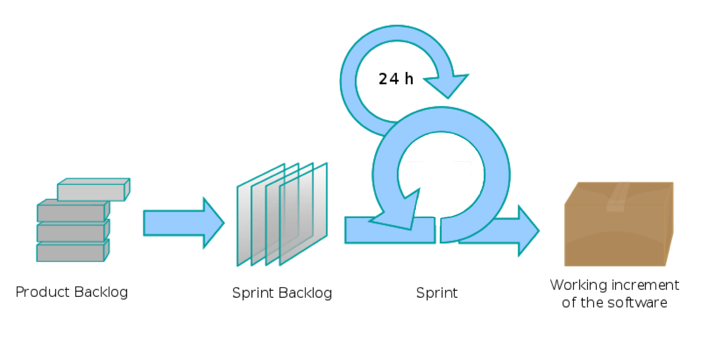
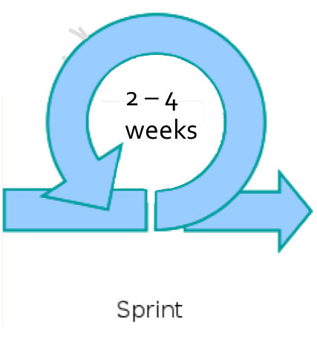


Sprint Overview
24 hrs
Planning Meeting
Stories selected & tasks created

Slide 90
Sprint Retrospective
Occurs after end-of-sprint presentation and release
Gives team chance to reflect on what happened in sprint
First focus on positives: what worked & why it worked
Things that sucked & how to improve discussed next
Meeting limited to 30 minutes; still agile process
Entire team participates; need all voices to do well
Everyone equal in meeting; democratic team, after all

